Slide 1


ASSIGNMENT 2 DESIGN THINKING APPROACH
--PALADI JAHNAVI

Slide 2
Agenda
✓ Problem Statement and Data Source ✓ Objective & Methodology ✓ Solution Description

Slide 3
PROBLEM STATEMENT
A man has took a shop in Rent near BTM Layout, Bangalore, not in the main road but as a local shop. The rent of the shop is 14000 per month. The man took the shop to sell fast food like - Biryani, Maggie, Egg Bhujia, Omlets, Chicken Kabab etc….

Slide 4
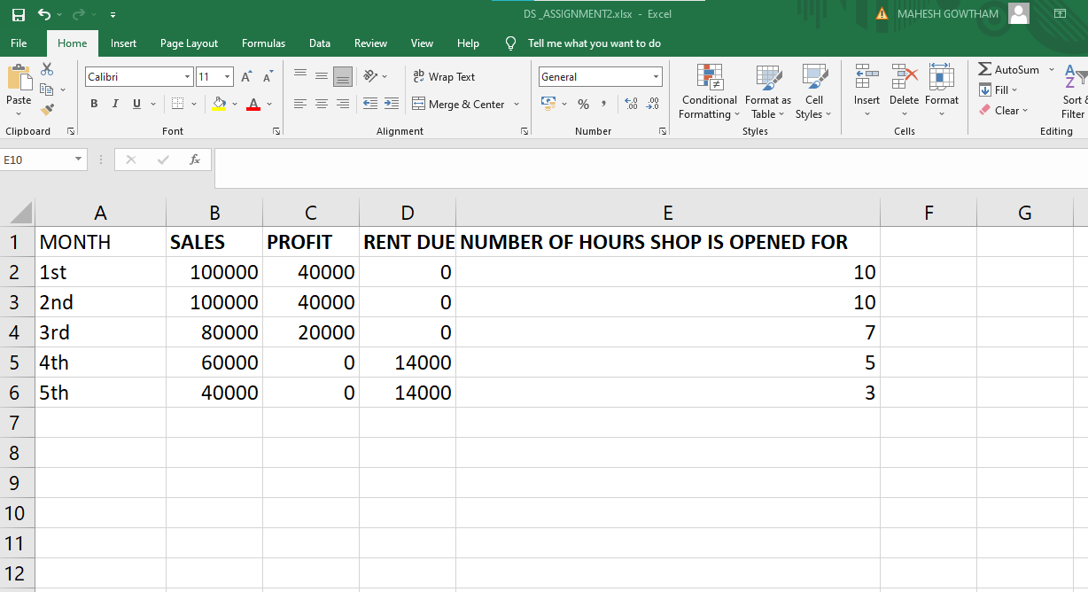
Objective & Methodology

Slide 5
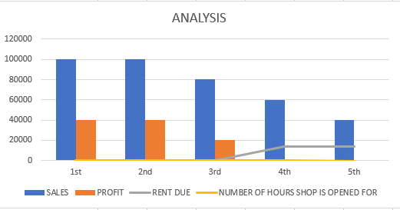

Slide 6
SOLUTION
We can observe that the number of hours the man worked are decreasing monthly .This maybe the main reason the sales are decreasing drastically.
As it is mentioned in the problem statement that he is lazy to work. This is the main reason his sales are declining. To increase his sales he needs to work hard.
The man does’not have his shop on main road . Many customers prefer shops on the main road. He can relocate if possible.
He can also increase the number of varieties of food available in his shop.

Slide 7

Shopkeeper can offer discounts to his regular customers which will help to retain them.
This Photo by Unknown Author is licensed under CC BY-NC

Slide 8
THANK YOU PALADI JAHNAVI

